Slide 1
ISO & GeoDCAT-AP pilot
Working Plan Proposal
ISO & GeoDCAT-AP Pilot - Phase 2 - Kick-off Meeting – December 5, 2025
Jordi Escriu, Hagar Lowenthal
European Commission, Joint Research Centre
Notes:
Cover slide option 1. Check layout for option 2 without the banner and footer

Slide 2
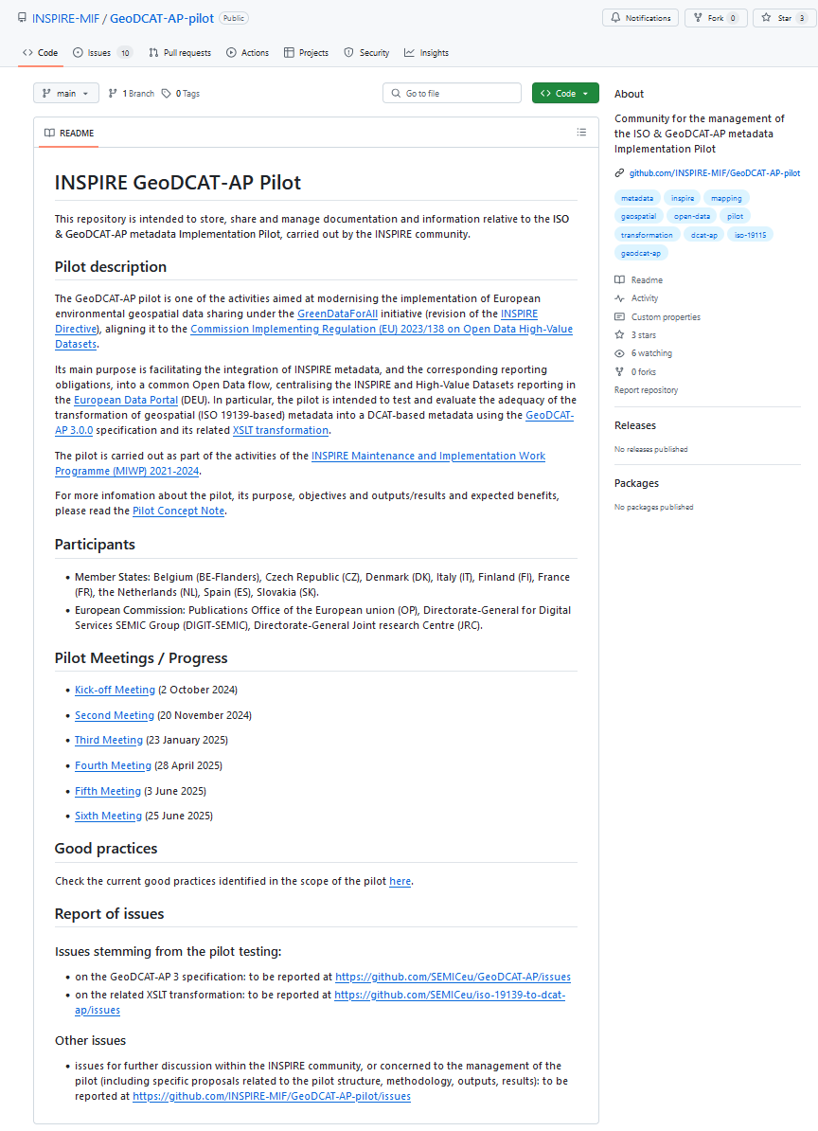

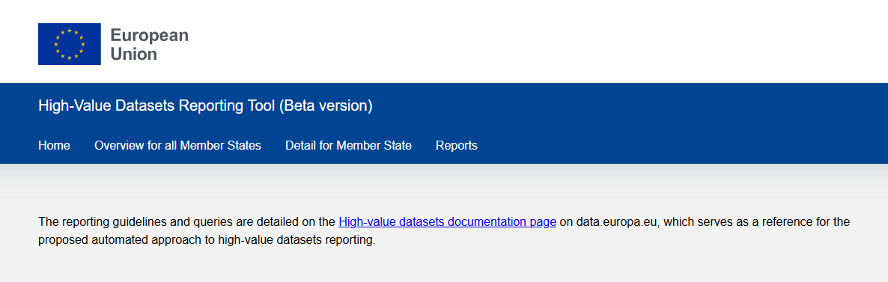


ISO & GeoDCAT-AP
Pilot
MIG Action 2.5 (URL)
Ad-hoc Subgroup on the Alignment of INSPIRE and High-Value Datasets implementation.
Cross-community collaboration activity.
https://github.com/INSPIRE-MIF/GeoDCAT-AP-pilot/

Slide 3
Phase 1
Overview

Slide 4

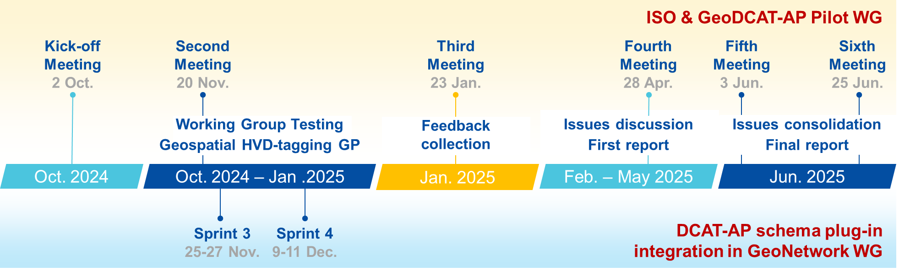
Pilot Phase 1
Finished in June 2025

Slide 5
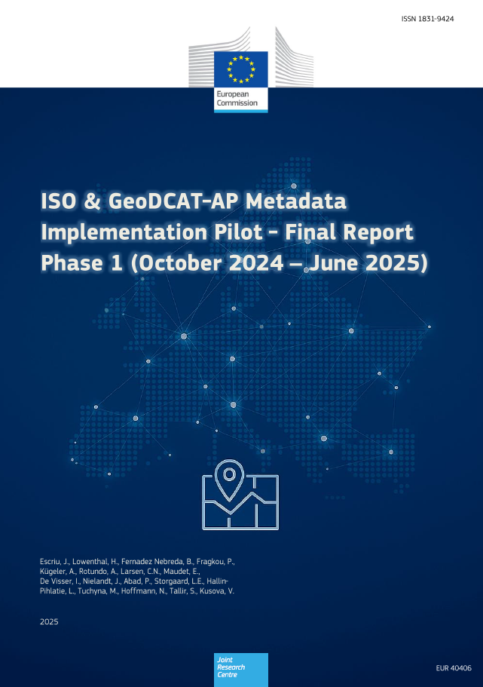

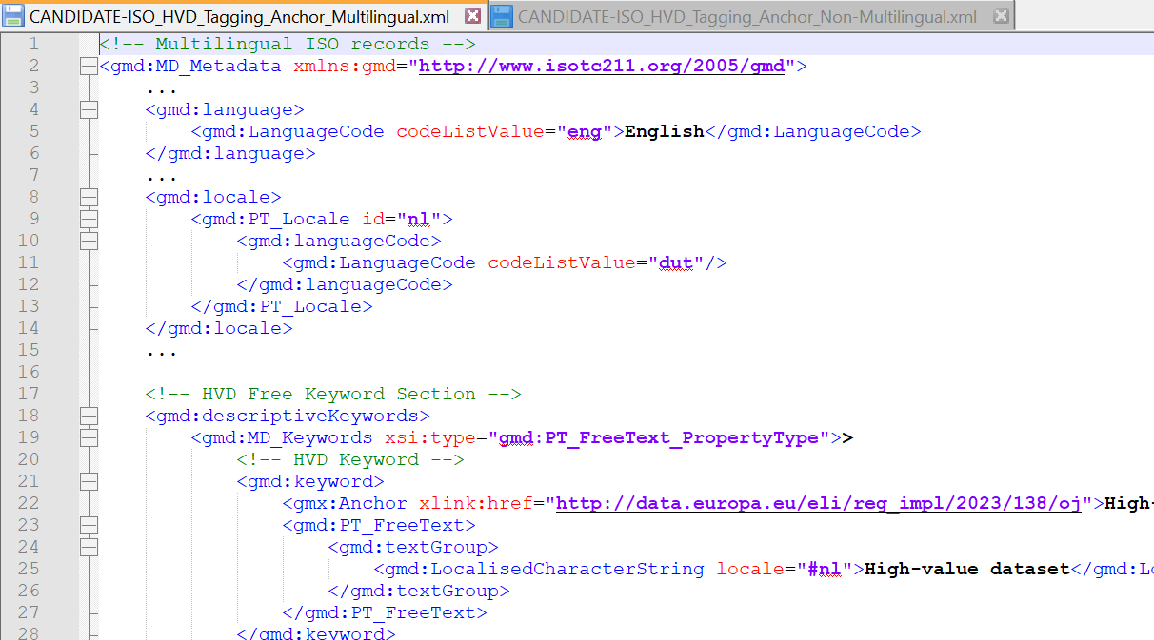
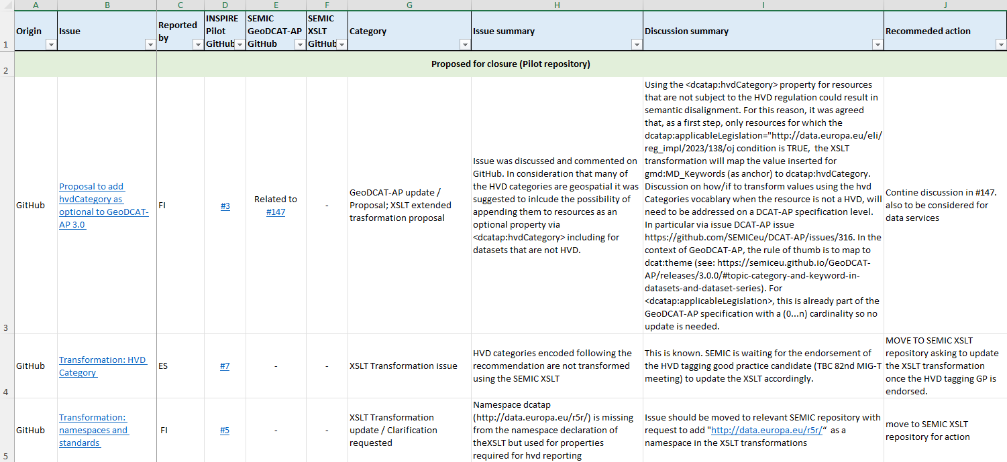
Pilot Phase 1
Main results
Continued support to geospatial HVDs reporting: Pilot Phase 2 - until Feb. 2027
Mono-lingual & Multi-lingual examples
Geospatial HVDs tagging good practice
Agreed way to identify and classify HVDs (category and subcategory)
Final Report - Pilot Phase 1
Expectations, testing approaches, issues identified and conclusions
Bunch of issues collected on GitHub
Issues-summary spreadsheet available, including issue classification and status

Slide 6

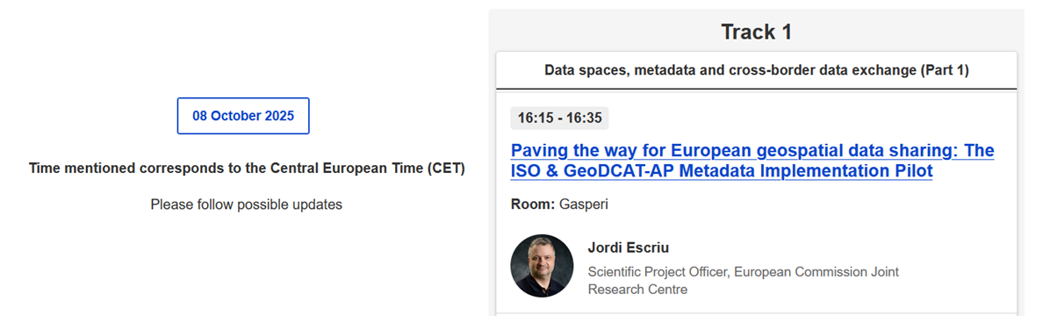
Paving the way for European geospatial data sharing:
The ISO & GeoDCAT-AP Metadata Implementation Pilot
Pilot Phase 1
We presented our results at…

Slide 7

Pilot Phase 1
Conclusions
Qualitative transformation maturity:
  Phase 1
    First step towards improving the GeoDCAT-AP specification / XSLT.
    Several issues still open, other yet to be discovered.
    No maturity evaluation performed.
  Tangible results:
    Encoding of geospatial High-Value Datasets (HVDs).
    SEMIC asset updates (GeoDCAT-AP specification / XSLT) by ~ end 2025.
  Member States
    Still facing migration of own tools / catalogues from DCAT/GeoDCAT v2 to v3.
    Implementing geospatial HVD-tagging good practice.

Slide 8
Pilot Phase 1
Challenges
Smooth integration of geospatial / INSPIRE data into data.europa.eu
  Continuous support to MSs on the identification and solution of transformation issues
  Geospatial data filtering in data.europa.eu
  Others to be identified
Quantitative measurement of metadata transformation maturity (reliable measurement)
Coordination / consistency / timely update of different existing transformations to GeoDCAT-AP (SEMIC / national and software solutions)
Specifics pending from Phase 1
  Common approach for describing Data Services & API endpoints
  Evaluation of potential metadata information losses for INSPIRE-compliant metadata records transformed to GeoDCAT format still ongoing

Slide 9
Phase 2
Objectives / Working Plan proposal

Slide 10

Phase 2
Objectives / Working Teams
T-1. Support to the alignment of INSPIRE to data.europa.eu
  T-1A. Management of geospatial metadata harvesting and reporting issues
  A forum for discussing issues, submitted (or to be submitted) to the relevant SEMIC GitHub repositories in the scope of geospatial datasets reporting (ISO / INSPIRE to GeoDCAT-AP), including geospatial HVDs.
  T-1B. Specific analysis and good practices for INSPIRE-data.europa.eu alignment
Team for performing specific analysis, discussing on and formalising common good practices in the scope of the alignment and integration of INSPIRE into data.europa.eu.
T-2. Exploration of the use of AI-powered tools for metadata management
  Team to explore and support the use of AI-assisted tools in metadata generation, and other potential uses in metadata management tasks.

Slide 11
Phase 2
Working Teams Tasks
T-1. Support to the alignment of INSPIRE to data.europa.eu
  T-1A. Management of geospatial metadata harvesting and reporting issues
  A forum for discussing issues, submitted (or to be submitted) to the relevant SEMIC GitHub repositories in the scope of geospatial datasets reporting (ISO / INSPIRE to GeoDCAT-AP), including geospatial HVDs.
    Identification of potential harvesting and reporting issues in the SEMIC repositories
    Community discussion and agreement on targeted solutions in GeoDCAT-AP
    GeoDCAT-AP specification and XSLT transformation updates (SEMIC)
    Inputs for / Outputs from T-1B

Slide 12
Phase 2
Working Teams Tasks
T-1. Support to the alignment of INSPIRE to data.europa.eu
  T-1B. Specific analysis and good practices for INSPIRE-data.europa.eu alignment
  Team for performing specific analysis, discussing on and formalising common good practices in the scope of the alignment and integration of INSPIRE into data.europa.eu.
    Geospatial-HVD tagging good practice (specification)
    Analysis of potential metadata information losses in the ISO-to-GeoDCAT-AP transformation
    Good practice for describing Data Services / APIs
    Discussing the need to cover other (selected) remaining gaps identified e.g., related to INSPIRE / HVD reporting, geospatial data filtering in data.europa.eu, analysis of specific changes needed to the TGs, etc.
    Inputs for / Outputs from T-1A

Slide 13
Phase 2
Working Teams Tasks
T-2. Exploration of the use of AI-powered tools for metadata management
Team to explore and support the use of AI-assisted tools in metadata generation, and other potential uses in metadata management tasks.
  Exploration and testing of AI-assisted tools for metadata generation
  Identification of other areas where AI-assisted tools may be used to support metadata management
  Other tasks (to be agreed)

Slide 14
Phase 2
Working Plan
Periodicity of meetings
Bi-monthly Pilot meetings starting from Jan. 2026 until ~ Feb. 2027
(At least) Monthly Working team meetings in between. More meetings depending on the needs identified.
Pilot leader + 1..N Team Co-leaders
Aspects to improve from Phase 1
Promote a more active participation - Essential to get useful results
Predefined planning of meetings
Constructive tips grasped from MS reports delivered today

Slide 15

Thank you
This presentation has been prepared for internal purposes. The information and views expressed in it do not necessarily reflect an official position
of the European Commission or of the European Union.
Except otherwise noted, © European Union (year). All Rights Reserved

